Slide 1
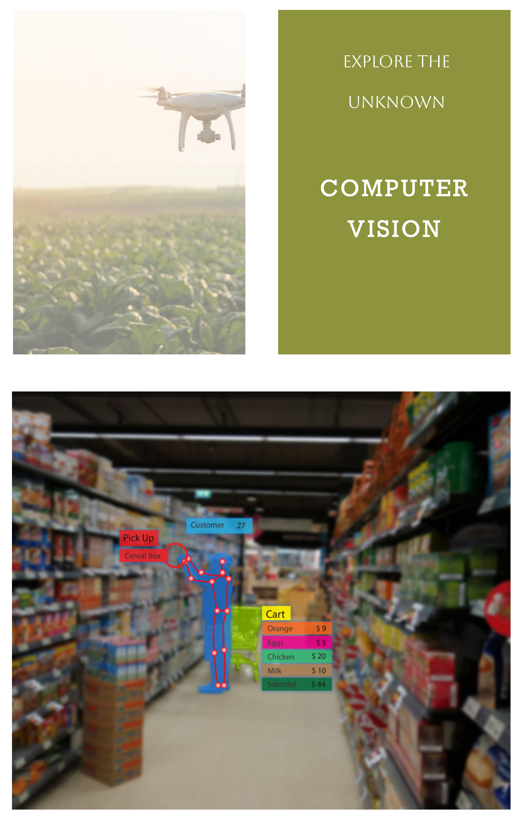
Computer Vision
Computer vision is a way of making computers see and understand the world around them through extracting meaningful information from images and videos. Computer vision uses artificial intelligence and machine learning to teach computers how to recognize and analyze different objects, scenes, and actions in visual data. For example, drones employ computer vision to navigate their flight path, identifying and avoiding obstacles, recognizing landing zones, and even tracking moving objects.
Computer vision is an important and exciting field of artificial intelligence that has beneficial applications for humans. Computer vision can help us save time, improve safety, and enhance health.

